Slide 1
Abscess
Assist prof. Luay Ahmed Naeem

Slide 2
abscess
An abscess is a cavity filled with pus and lined by a pyogenic membrane. This pyogenic membrane consists of dead tissue cells and a wall of granulation tissue consisting for the most part of phagocytic histiocytes.

Slide 3
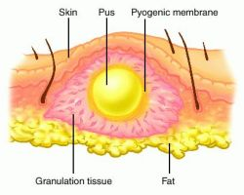

Slide 5
Causes
Abscesses are caused by bacterial infection, parasites, and foreign substances. Bacterial infection is the most common cause. Often many different types of bacteria are involved in a single infection. The most common bacteria present is Staphylococcus aureus, Streptococcus, Corynebacterium, E. coli etc.
Rarely parasites can cause abscesses and this is more common in the developing world. Specific parasites known to do this include myiasis (maggots).

Slide 6
Signs and symptoms
Abscesses may occur in any kind of solid tissue but most frequently on skin surface (where they may be superficial pustules (boils) or deep skin abscesses. In the lungs, brain, teeth, kidneys and tonsils are internal abscess. Major complications are spreading of the abscess material to adjacent tissues and extensive regional tissue death (gangrene).
The main symptoms and signs of a skin abscess are redness, heat, swelling, pain and loss of function. There may also be high temperature (fever) and chills.

Slide 7
Internal abscess is more difficult to identify, but signs include pain in the affected area, a high temperature, and generally feeling unwell. Internal abscesses rarely heal themselves, so prompt medical attention is indicated if such an abscess is suspected. An abscess could potentially be fatal (although this is rare) if it compresses vital structures such as the trachea in the context of a deep neck abscess.
If superficial, abscesses may be fluctuant when palpated. This is a wave-like motion which is caused by movement of the pus inside the abscess.

Slide 8
Most often, an abscess becomes a painful, compressible mass that is red, warm to touch, and tender.
As some abscesses progress, they may "point" and come to a head so you can see the material inside and then spontaneously open (rupture).
Most will continue to get worse without care. The infection can spread to the tissues under the skin and even into the bloodstream.
If the infection spreads into deeper tissue, you may develop a fever and begin to feel ill.

Slide 9
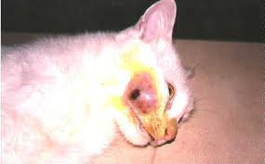

Slide 10
Classification of Abscess
Abscesses may be classified (generally) as either skin abscesses or internal abscesses. Skin abscesses are common; internal abscesses tend to be harder to diagnose, and more serious. Skin abscesses are also called cutaneous or subcutaneous abscess.
Abscess can be classified into :
Acute abscess(hot).
Chronic abscess(cold).
Superficial abscess.
Deep abscess.

Slide 11
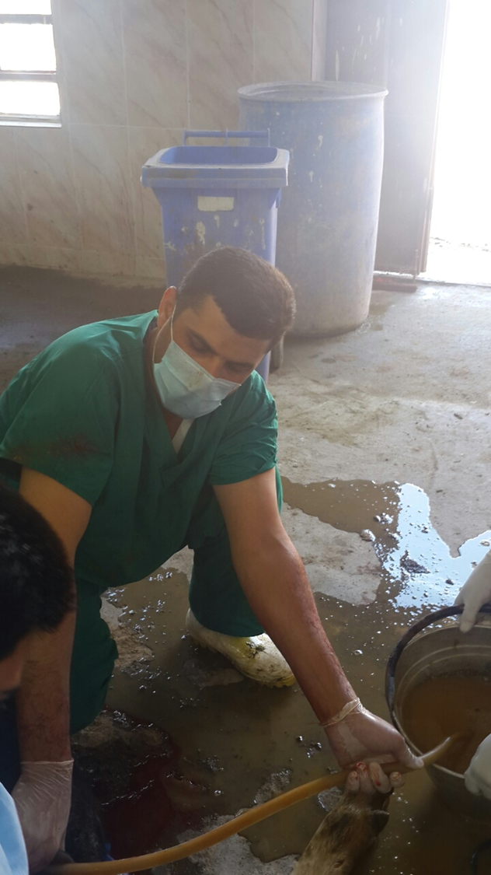

Slide 12
Differential Diagnosis
Tumor
Cyst
Hygroma
Hematoma
Hernia

Slide 13
Treatment
The basic principle of treatment of an abscess are:
to drain the pus;
to send a sample of pus for culture and sensitivity test;
to give proper antibiotic

Slide 14
Surgical procedure
maturation (ripening):
hot fomentation (poultices)
application of irritant (povidone-iodine)
preparation the site of operation.
evacuation the content (drainage).
opening at the most dependent part.
the curetted area must be last enough.
apply antiseptic (hydrogen peroxide, povidone).
antibiotics (locally and systematic).

